Slide 1
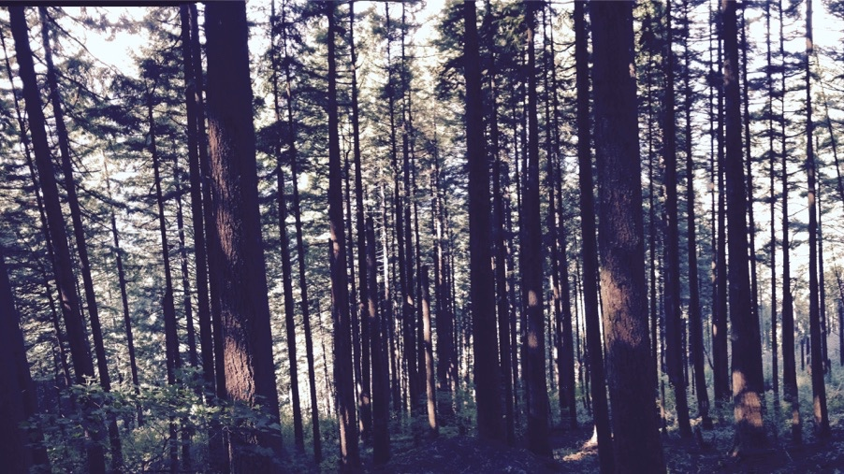
Plants aren’t dumb Using optimality theory to understand big questions in plant ecophysiology
Nick Smith
Department of Biological Sciences
Texas Tech University
nick.smith@ttu.edu; @nick_greg_smith

Slide 2
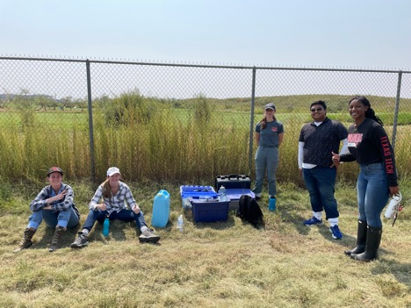
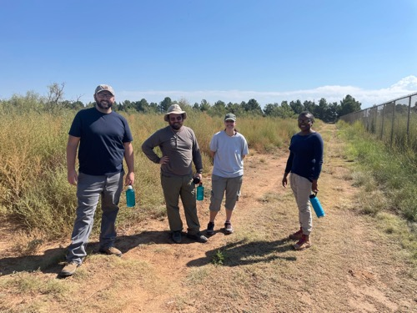
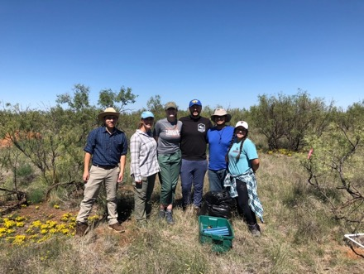
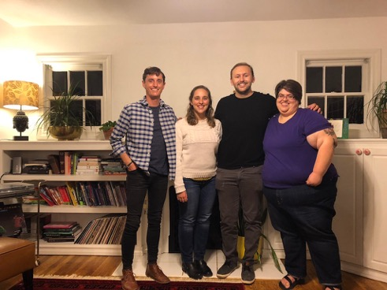





Acknowledgements
nick.smith@ttu.edu; @nick_greg_smith
Current lab group
Jeff Chieppa (postdoc)
Brad Posch (postdoc)
Evan Perkowski (PhD student)
Zinny Ezekannagha (PhD student)
Risa McNellis (MS; now lab tech)
Morgan Appell (undergrad)
Joseph Terrones (undergrad)
Former lab group
Lizz Waring (postdoc; now Asst. Prof at Northeastern State U)
Helen Scott (MS; now in industry and PhD student at BU)
Jorge Ochoa (undergrad; now working for the Army)
Jose Villeda (undergrad; now in industry)
Leah Ortiz (undergrad; now in industry)
Collaborators at TTU and around the world
Funding
NSF
USDA
NPS
USGS
Schmidt Futures

Slide 3
Why do people care about plants?
nick.smith@ttu.edu; @nick_greg_smith

Slide 4
Why do people care about plants?
nick.smith@ttu.edu; @nick_greg_smith

Slide 5
Why do people care about plants?
nick.smith@ttu.edu; @nick_greg_smith

Slide 6
Why do people care about plants?
nick.smith@ttu.edu; @nick_greg_smith

Slide 7
Why do people care about plants?
nick.smith@ttu.edu; @nick_greg_smith

Slide 8
Why do people care about plants?
nick.smith@ttu.edu; @nick_greg_smith

Slide 9
Why do people care about plants?
nick.smith@ttu.edu; @nick_greg_smith

Slide 10
Why do people care about plants?
nick.smith@ttu.edu; @nick_greg_smith

Slide 11
Why do people care about plants?
nick.smith@ttu.edu; @nick_greg_smith

Slide 12
In other words: plants impact ecosystem services…
nick.smith@ttu.edu; @nick_greg_smith

Slide 13
…including climate!
nick.smith@ttu.edu; @nick_greg_smith

Slide 14
…including climate!
nick.smith@ttu.edu; @nick_greg_smith

Slide 15
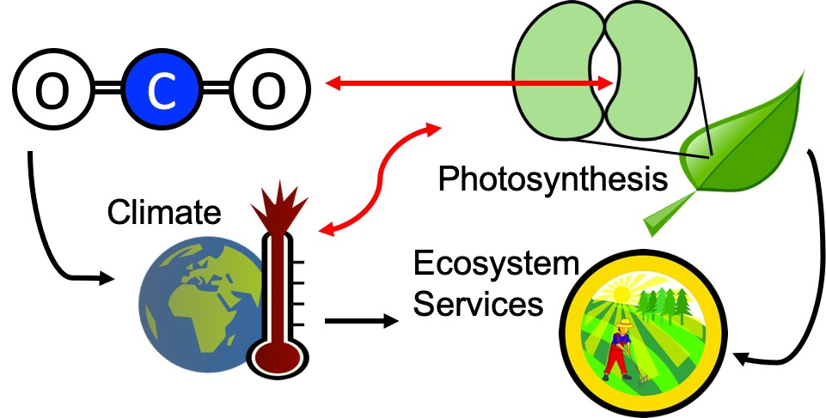
Our lab examines photosynthesis as a regulator of global change impacts on ecosystem services
nick.smith@ttu.edu; @nick_greg_smith

Slide 16
Photosynthesis is important!
nick.smith@ttu.edu; @nick_greg_smith

Slide 17
Photosynthesis is important!
nick.smith@ttu.edu; @nick_greg_smith
Data from IPCC (2013)

Slide 18
Photosynthesis is important!
nick.smith@ttu.edu; @nick_greg_smith
Photosynthesis
Data from IPCC (2013)

Slide 19
But predictions are uncertain!
nick.smith@ttu.edu; @nick_greg_smith
Friedlingstein et al. (2014)

Slide 20
But predictions are uncertain!
nick.smith@ttu.edu; @nick_greg_smith
Future model uncertainty (14 Pg) > current fossil fuel emissions (9.5 Pg)
Friedlingstein et al. (2014)

Slide 21
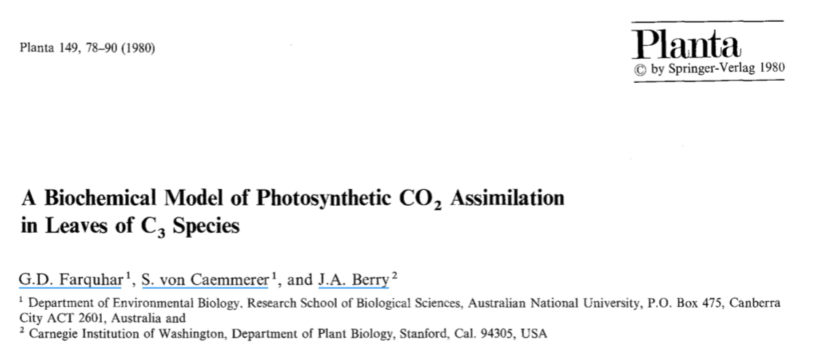
Theoretical models for photosynthesis exist
nick.smith@ttu.edu; @nick_greg_smith

Slide 22
These produce short term responses that match data
nick.smith@ttu.edu; @nick_greg_smith

Slide 23
Long-term responses can differ from short-term responses due to acclimation
nick.smith@ttu.edu; @nick_greg_smith

Slide 24
Long-term responses can differ from short-term responses due to acclimation
nick.smith@ttu.edu; @nick_greg_smith
Dumb plants

Slide 25
Plants acclimate to environmental conditions
nick.smith@ttu.edu; @nick_greg_smith
Level of operation
Population
Adaptation
Plant
Acclimation
Leaf
Instantaneous response
Cell
Seconds
Minutes
Days
Years
Decades
Centuries
Response time
Smith and Dukes (2013)

Slide 26
Long-term responses can differ from short-term responses due to acclimation
nick.smith@ttu.edu; @nick_greg_smith
Acclimated to high light
Acclimated to low light

Slide 27
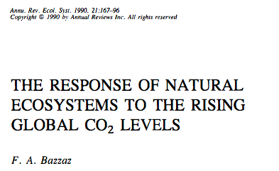
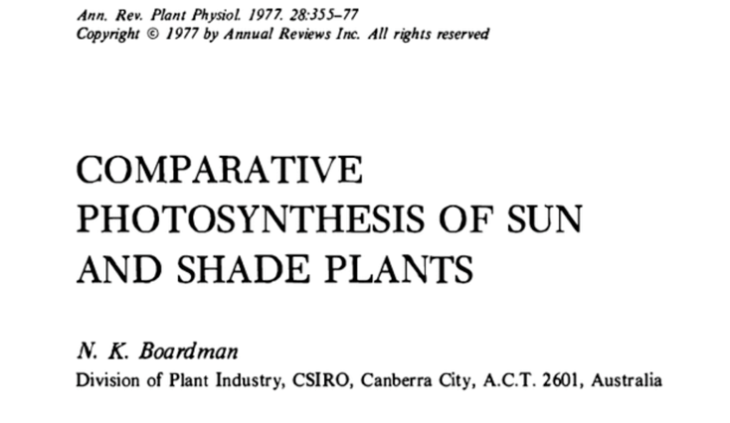
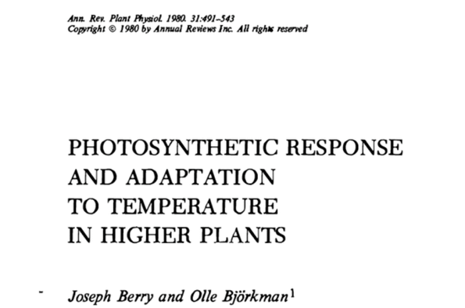
Acclimation is ubiquitous and well known…
nick.smith@ttu.edu; @nick_greg_smith
Temperature: Berry & Björkman (1980)
CO₂: Bazzaz (1990)
Light: Boardman (1977)

Slide 28
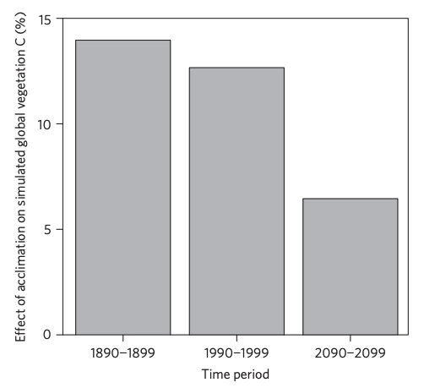
…and can impact carbon cycling and climate…
nick.smith@ttu.edu; @nick_greg_smith
Acclimation increase future C storage by ~6%
Acclimation alters future temperature by >1°C
Smith et al. (2017) Nature Climate Change
Smith et al. (2017) JAMES

Slide 29
…but the mechanisms underlying photosynthetic acclimation are not well known
nick.smith@ttu.edu; @nick_greg_smith

Slide 30
Solution: A testable, theoretical model!
nick.smith@ttu.edu; @nick_greg_smith

Slide 31
Optimization: Least cost theory
nick.smith@ttu.edu; @nick_greg_smith
Maintain fastest rate of photosynthesis at the lowest cost (water and nutrient use)
Wright et al. (2003) American Naturalist

Slide 32
Least cost theory
nick.smith@ttu.edu; @nick_greg_smith
[TALK TO ME LATER ABOUT THE MATHS]
Wright et al. (2003). American Naturalist
Prentice et al. (2014). Ecology Letters
Wang et al. (2017). Nature Plants
Smith et al. (2019). Ecology Letters
Stocker et al. (2019). Geoscientific Model Development Discussion

Slide 33
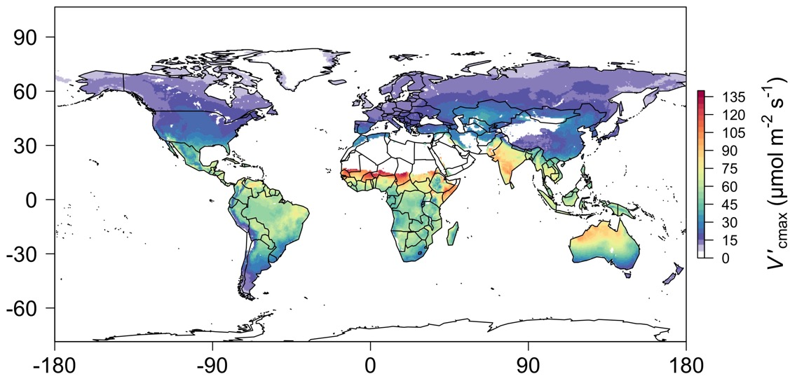
nick.smith@ttu.edu; @nick_greg_smith
We can predict optimal traits in different environments
Trait of interest*
*Traits include: investment in photosynthetic machinery (e.g., Vcmax, Jmax), investment in leaf construction (e.g., LMA), nutrient use (e.g., leaf N)
Smith et al. (2019) Ecology Letters

Slide 34
Ok, great, but now what?
nick.smith@ttu.edu; @nick_greg_smith

Slide 35
We can use the theory as a null model to explore acclimation mechanisms
nick.smith@ttu.edu; @nick_greg_smith

Slide 36
Let’s tackle some big questions in plant ecophysiology!
nick.smith@ttu.edu; @nick_greg_smith

Slide 37
Question 1: Is photosynthesis optimized to the environment?
nick.smith@ttu.edu; @nick_greg_smith

Slide 38
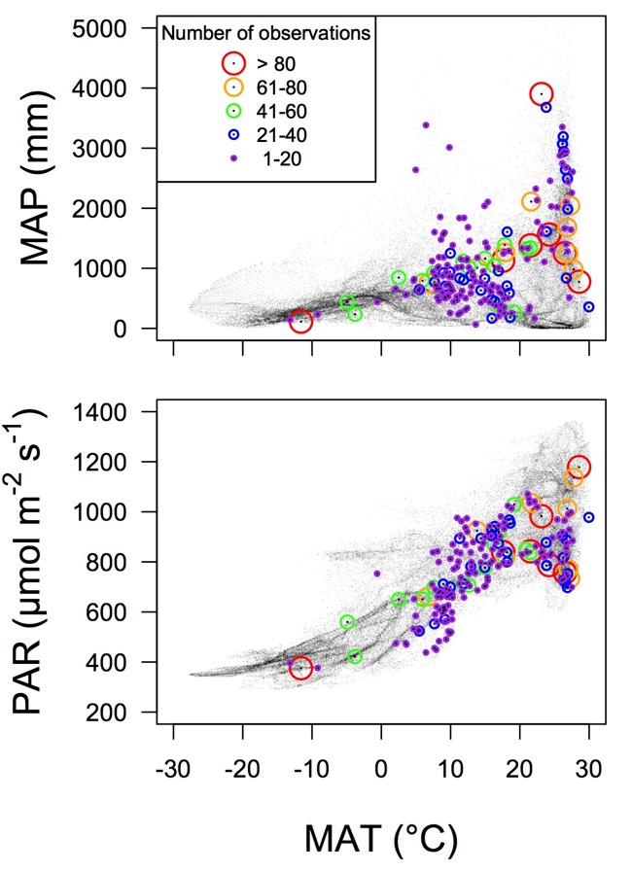
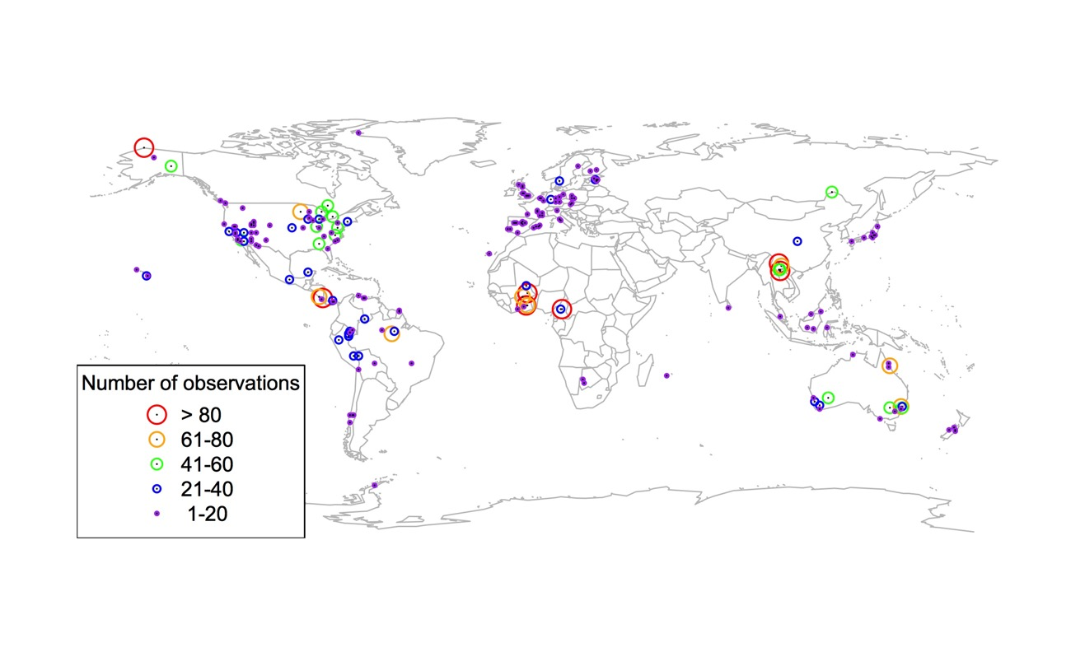
Global V_{cmax} dataset
nick.smith@ttu.edu; @nick_greg_smith
3,697 measurements
202 sites
> 600 genera
Smith et al. (2019) Ecology Letters

Slide 39

nick.smith@ttu.edu; @nick_greg_smith
Smith et al. (2019)

Slide 40
nick.smith@ttu.edu; @nick_greg_smith
Optimal V_{cmax} is similar to observed values
Smith et al. (2019)

Slide 41
Question 1: Is photosynthesis optimized to the environment? YES! Photosynthesis acclimates spatially as expected from optimization
nick.smith@ttu.edu; @nick_greg_smith

Slide 42
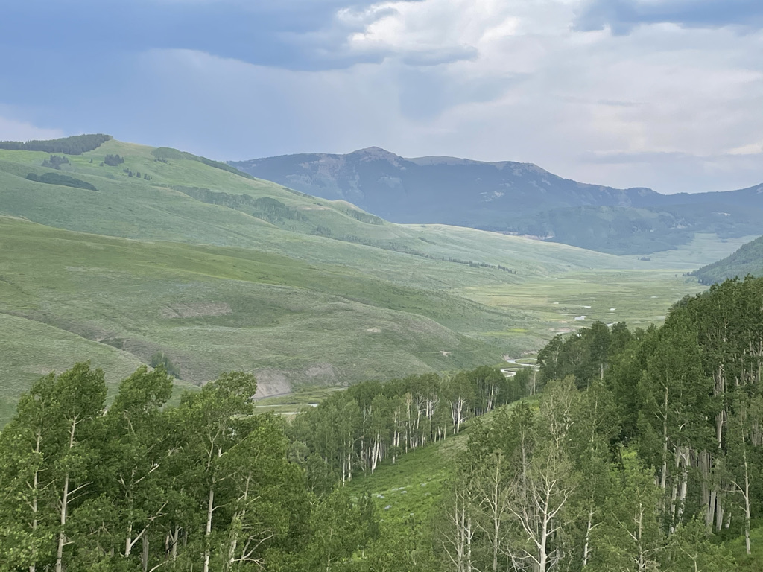
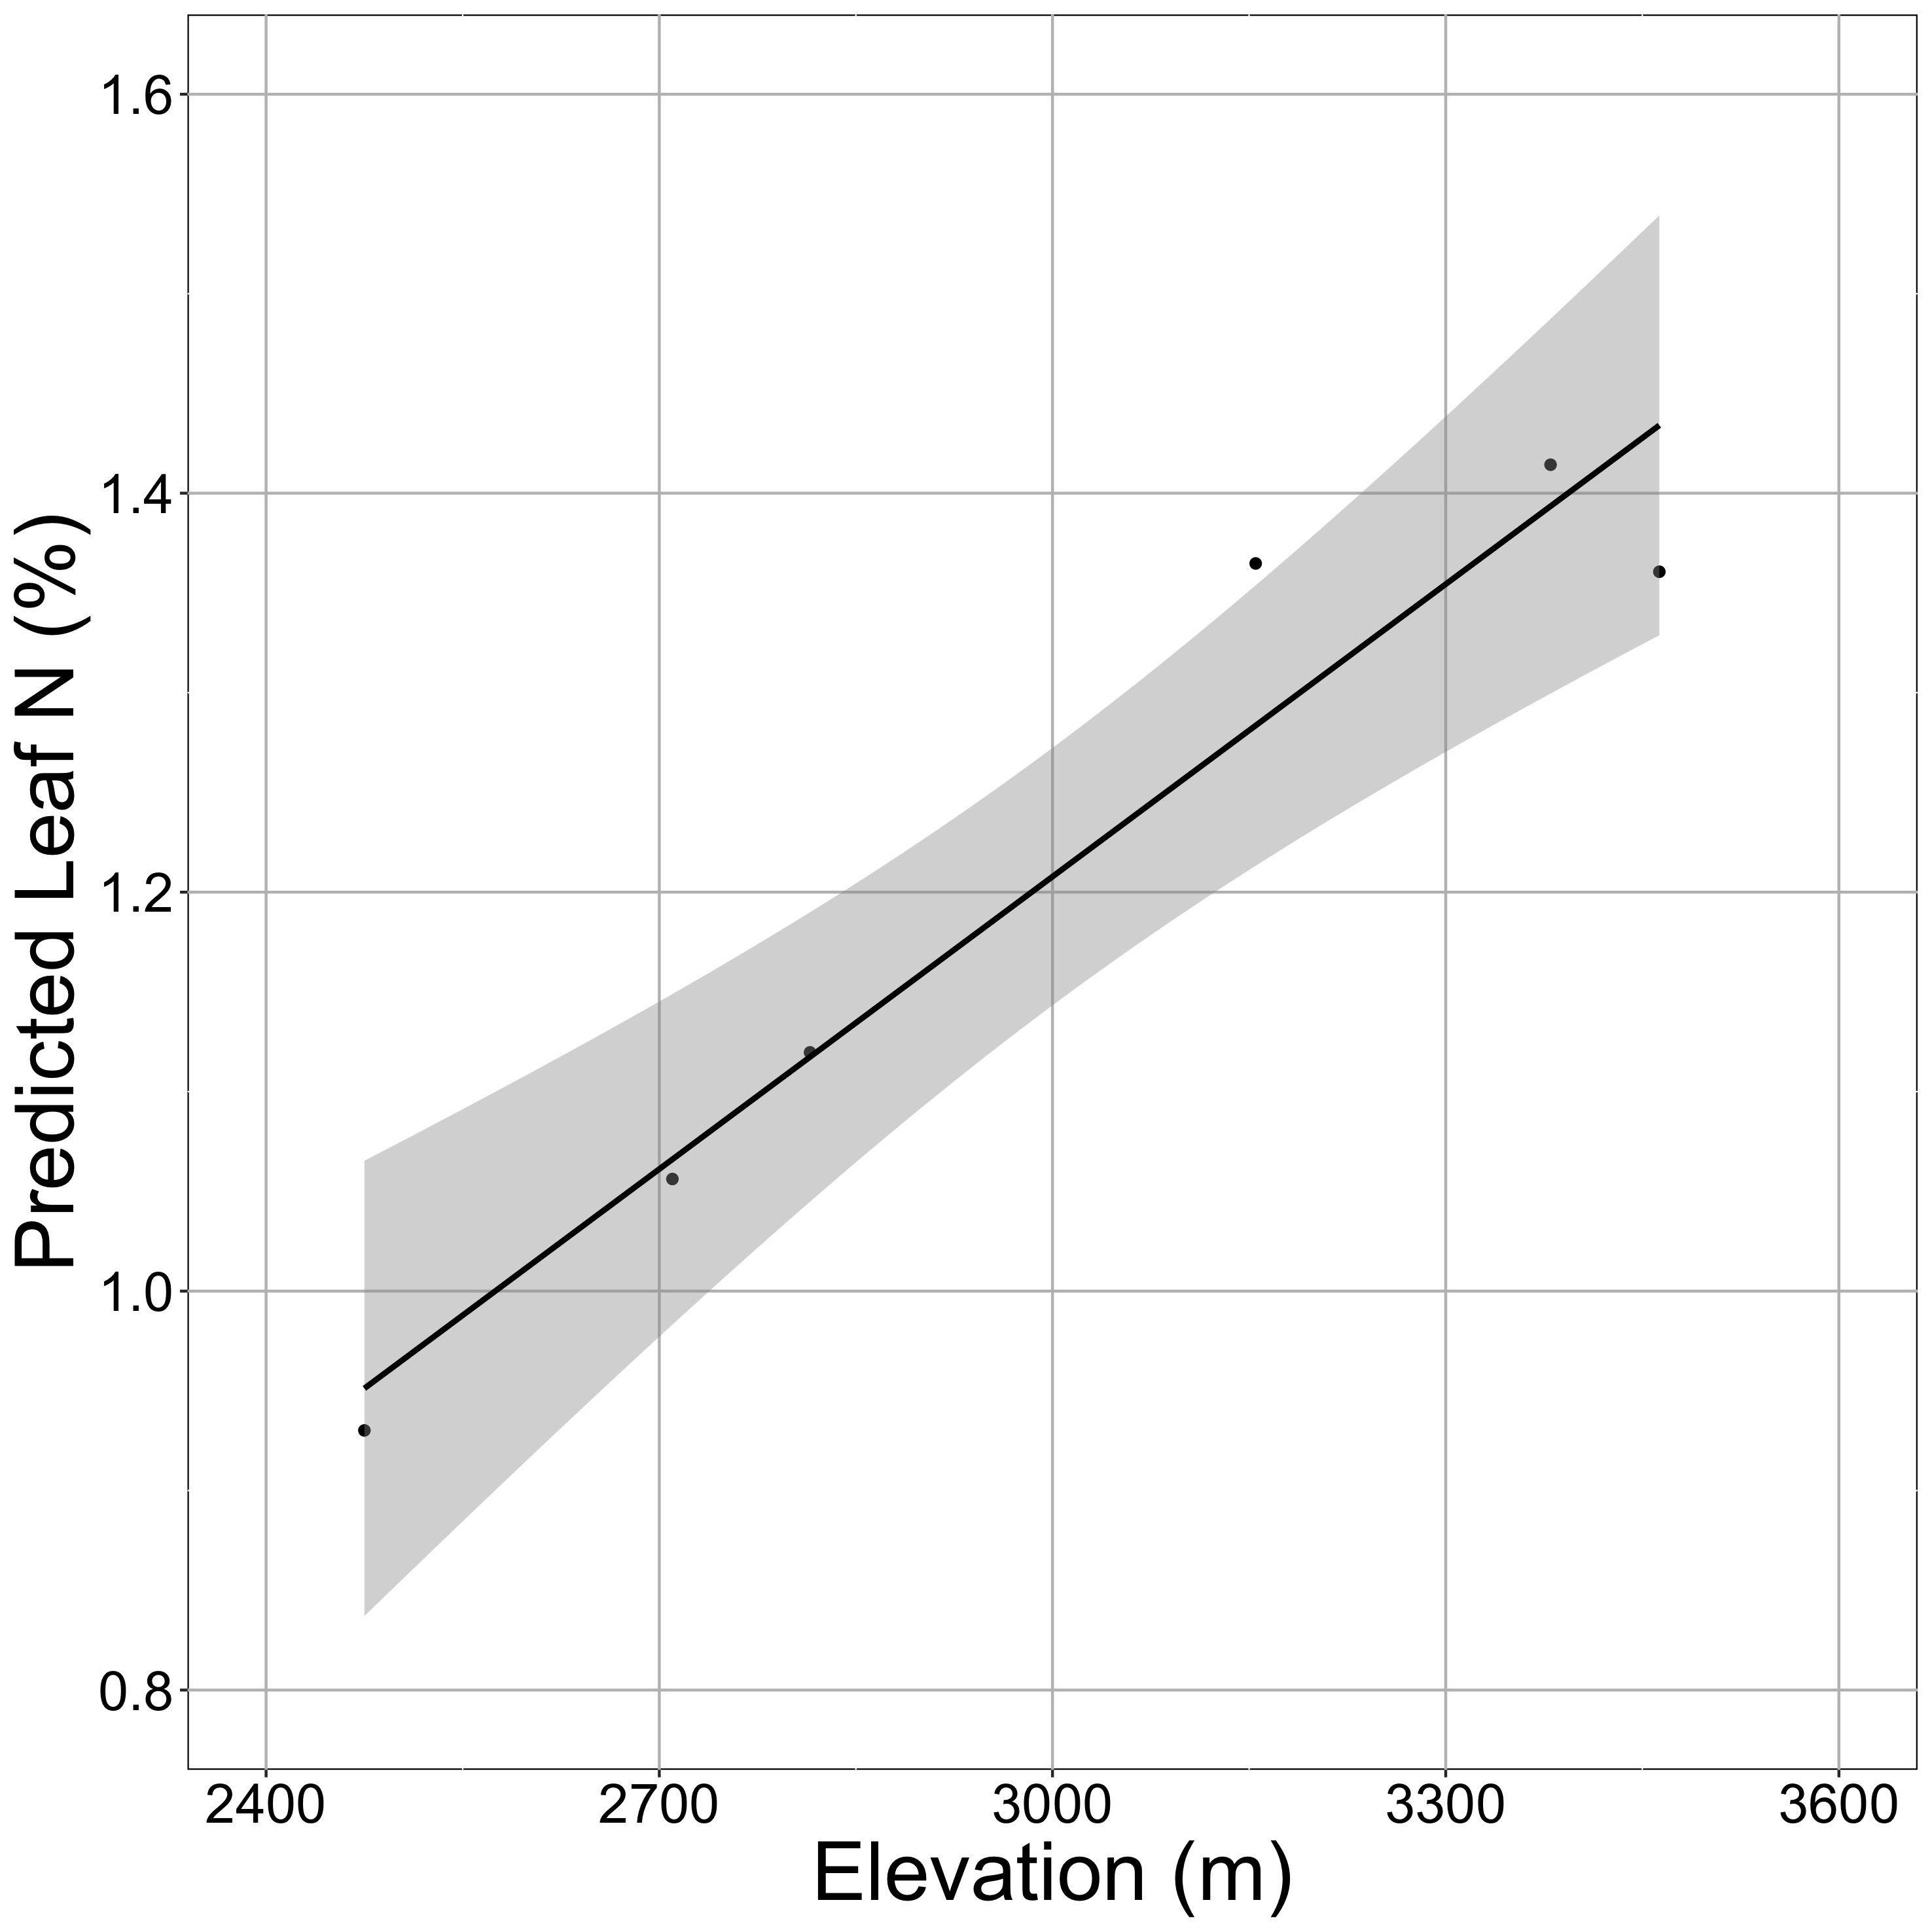
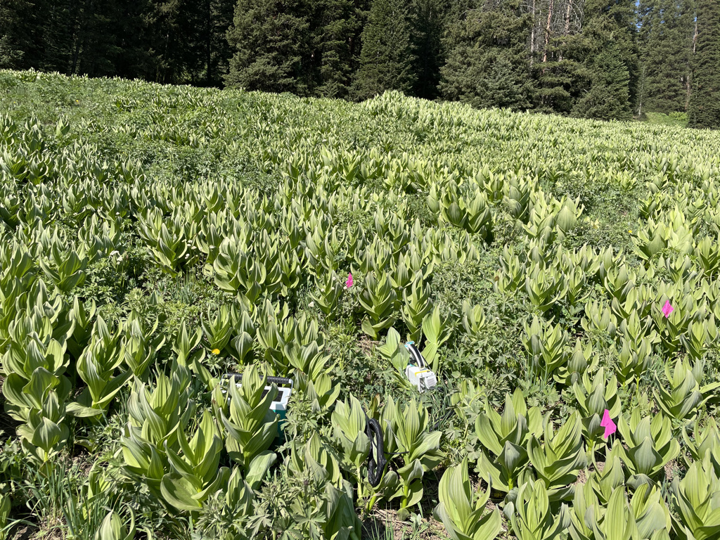

Looking forward: more acclimation predictions in more places to examine larger scale impacts
nick.smith@ttu.edu; @nick_greg_smith

Slide 43
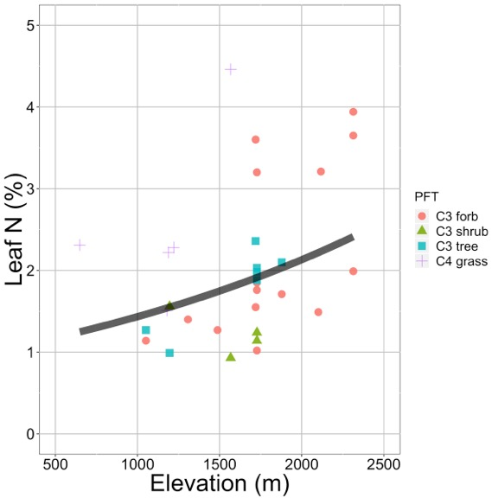
Looking forward: herbarium specimens to examine acclimation over space and time
nick.smith@ttu.edu; @nick_greg_smith
Plants increased leaf N investment with elevation. This response was predicted by acclimation theory.
Villeda et al. (in prep)

Slide 44
Question 2: Does photosynthesis respond to soil nutrients?
nick.smith@ttu.edu; @nick_greg_smith

Slide 45
Two options from theory
nick.smith@ttu.edu; @nick_greg_smith
Use added nitrogen to increase photosynthetic enzymes to maintain rates of photosynthesis at a lower water use
Use added nitrogen to increase biomass without a change in photosynthetic traits

Slide 46
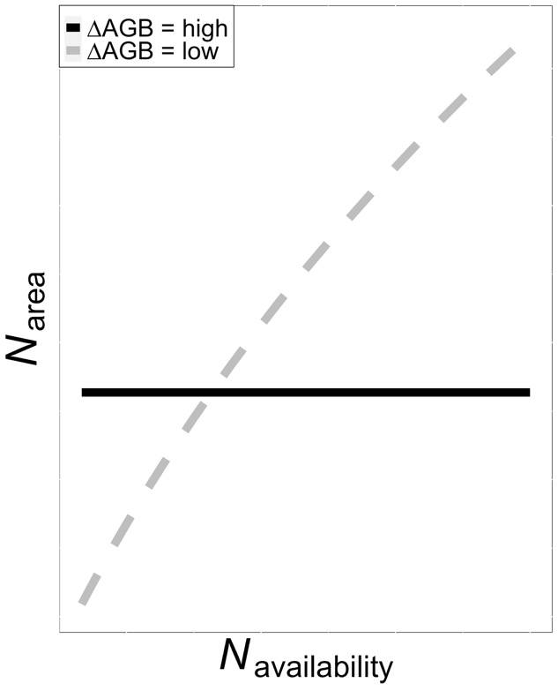
Two options from theory
nick.smith@ttu.edu; @nick_greg_smith

Slide 47
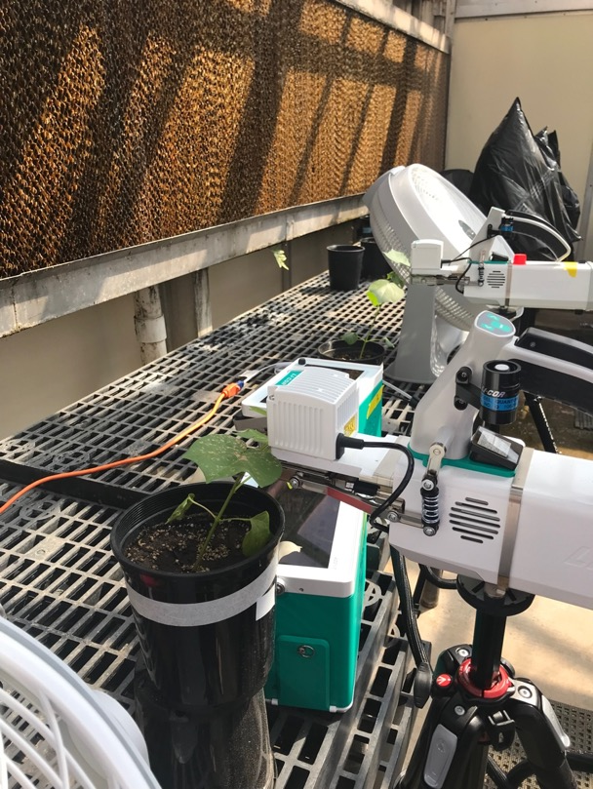
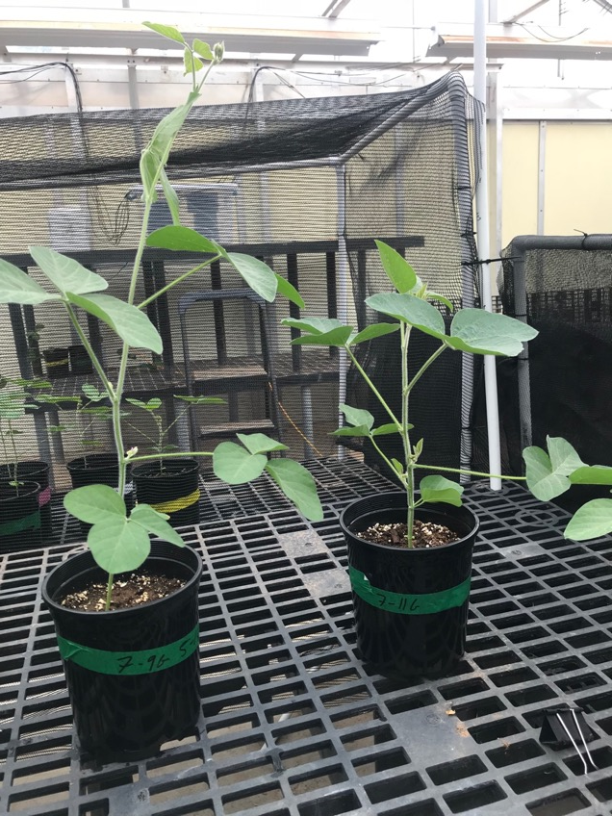
Let’s test it experimentally
nick.smith@ttu.edu; @nick_greg_smith

Slide 48
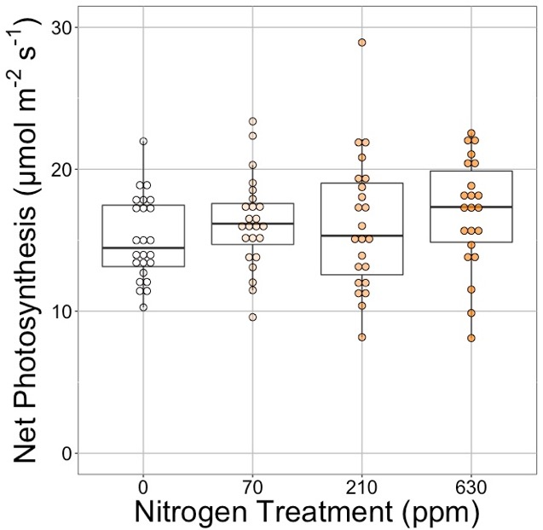
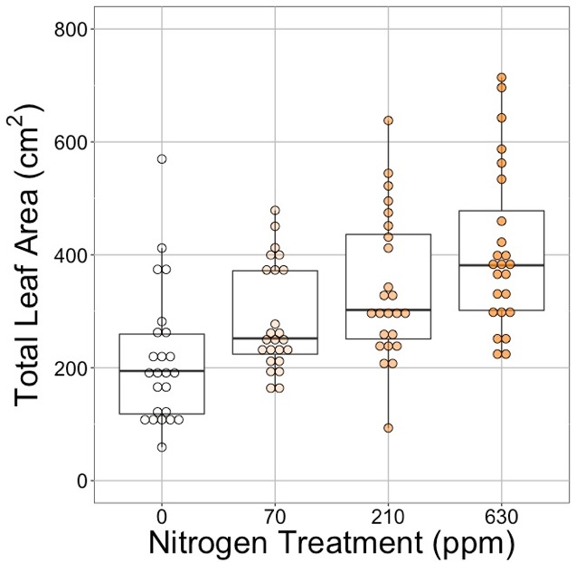
nick.smith@ttu.edu; @nick_greg_smith
Waring and Smith (in prep)

Slide 49
nick.smith@ttu.edu; @nick_greg_smith
No change (P = 0.42)
Waring and Smith (in prep)

Slide 50
Leaf area, but not photosynthesis increases with N addition
nick.smith@ttu.edu; @nick_greg_smith
No change (P = 0.42)
91% increase (P < 0.05)
Waring and Smith (in prep)

Slide 51
But do greenhouse experiments translate to the field?
nick.smith@ttu.edu; @nick_greg_smith

Slide 52
nick.smith@ttu.edu; @nick_greg_smith
Grassland soil nutrient addition network:
Leaf area index
Per-leaf-area nitrogen (photosynthetic proxy)

Slide 53
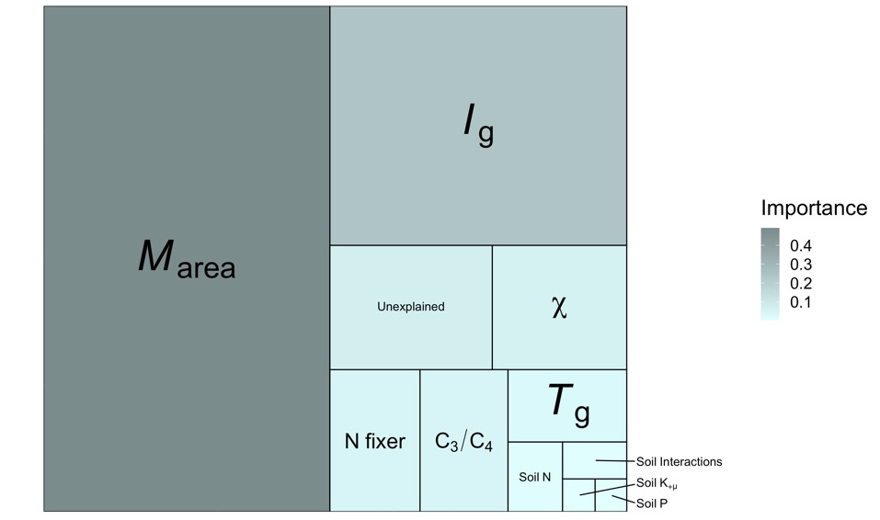
Globally, soil N addition has little impact on leaf N relative to plant traits (*) and the environment (†)
nick.smith@ttu.edu; @nick_greg_smith
†
*
*
†
*
*
Each box is proportional to the variance in leaf N explained by each variable
Smith et al. (in prep)

Slide 54
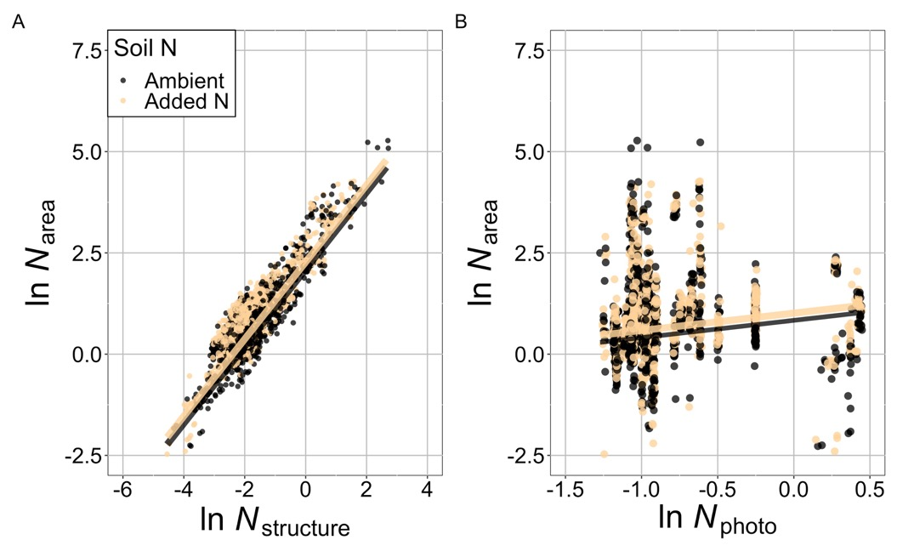
Climate and leaf traits alone can predict leaf N globally
nick.smith@ttu.edu; @nick_greg_smith
Smith et al. (in prep)

Slide 55
Two options from theory
nick.smith@ttu.edu; @nick_greg_smith
Use added nitrogen to increase photosynthetic enzymes to maintain rates of photosynthesis at a lower water use
Use added nitrogen to increase biomass without a change in photosynthetic traits

Slide 56
Two options from theory
nick.smith@ttu.edu; @nick_greg_smith

Slide 57
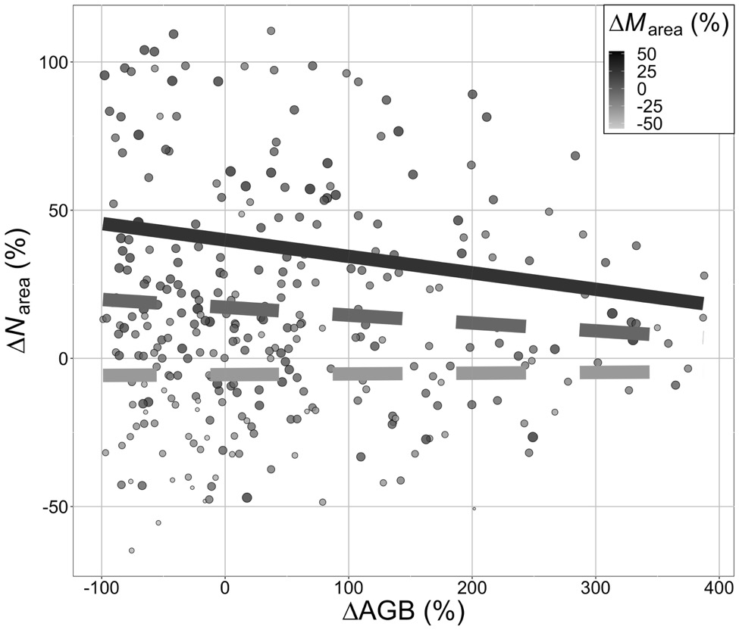
Is plant allocation to leaf N dependent on allocation to biomass?
nick.smith@ttu.edu; @nick_greg_smith
Smith et al. (in prep)

Slide 58
To see a leaf N response to soil N there must be (1) added investment to leaves and (2) small investment to biomass
nick.smith@ttu.edu; @nick_greg_smith
Smith et al. (in prep)

Slide 59
Question 2: Does photosynthesis respond to soil nutrients? Generally no, plants respond to added nutrients by increasing leaf area, but this is complicated by whole-plant allocation decisions
nick.smith@ttu.edu; @nick_greg_smith

Slide 60
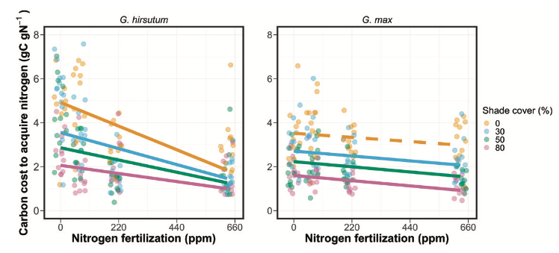
Looking forward: symbioses as modifiers of plant economies under variable conditions
nick.smith@ttu.edu; @nick_greg_smith
Soybean (right panel) economics are much less responsive to soil nitrogen than cotton (left panel)
Perkowski et al. (2021)

Slide 61
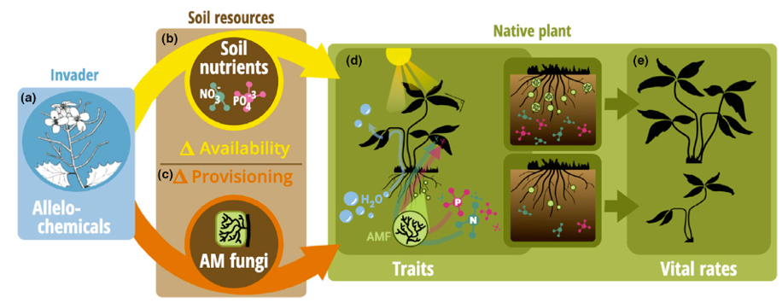
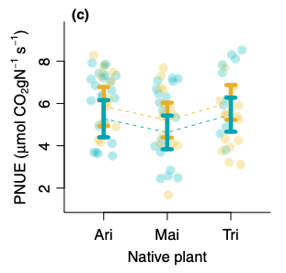
Looking forward: impact of allelopathic invaders on leaf economics
nick.smith@ttu.edu; @nick_greg_smith
Allelopathic invasion (gold) increased photosynthetic N use efficiency of native plants. This response was predicted by acclimation theory.
Bialic-Murphy et al. (2021)

Slide 62

Question 3: What does acclimation mean for future conditions?
nick.smith@ttu.edu; @nick_greg_smith

Slide 63
Photosynthetic traits change with future conditions in ways expected from optimization
nick.smith@ttu.edu; @nick_greg_smith
mean: -12%
mean: -15%
(P > 0.05)
Smith and Keenan (2020)

Slide 64
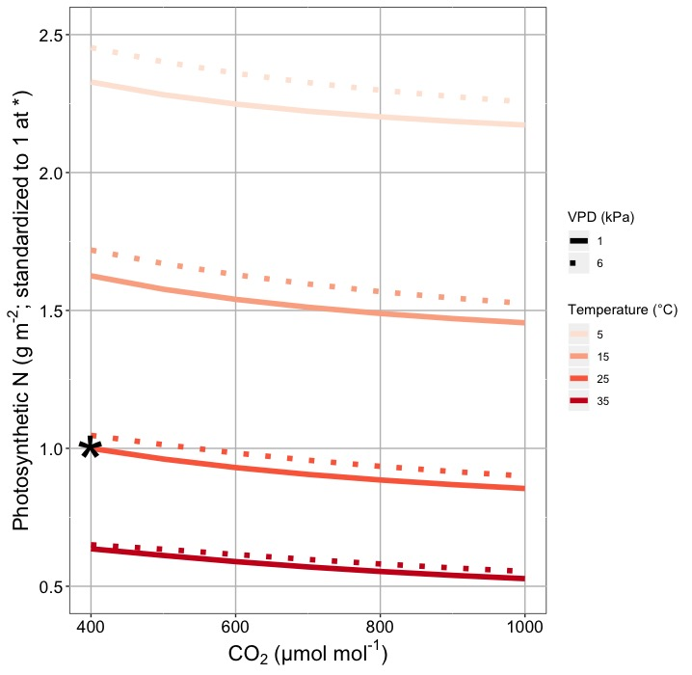
This generally suggests lower nitrogen demand under warmer, high CO₂ conditions
nick.smith@ttu.edu; @nick_greg_smith
Smith and Keenan (2020)

Slide 65
Let’s run a model out into the future!
nick.smith@ttu.edu; @nick_greg_smith

Slide 66
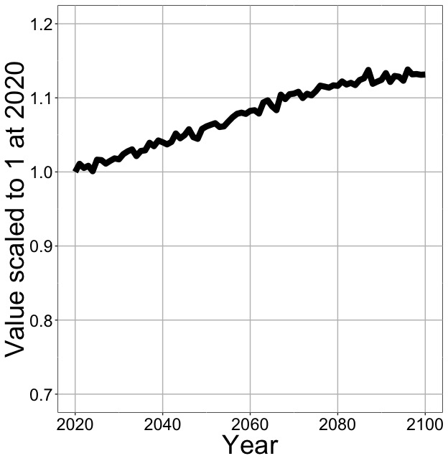
Photosynthesis increases in future
nick.smith@ttu.edu; @nick_greg_smith
Net Photosynthesis
Smith et al. (in prep)

Slide 67
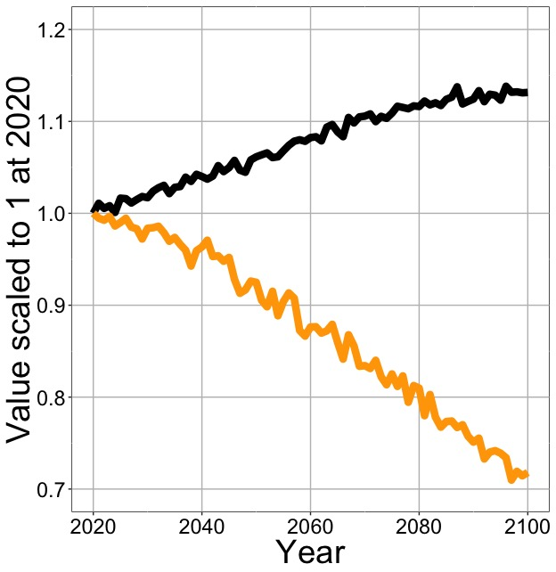
Photosynthesis increases in future (at lower nutrient use)
nick.smith@ttu.edu; @nick_greg_smith
Net Photosynthesis
Leaf Nitrogen
Smith et al. (in prep)

Slide 68
Need to rethink nutrient limitation in models?
“No limitation” simulation
“Nutrient limitation” simulations
Weider et al. (2015)

Slide 69
Question 3: What does acclimation mean for future conditions? Photosynthesis will increase and per-leaf-area nutrient use will decrease
nick.smith@ttu.edu; @nick_greg_smith

Slide 70
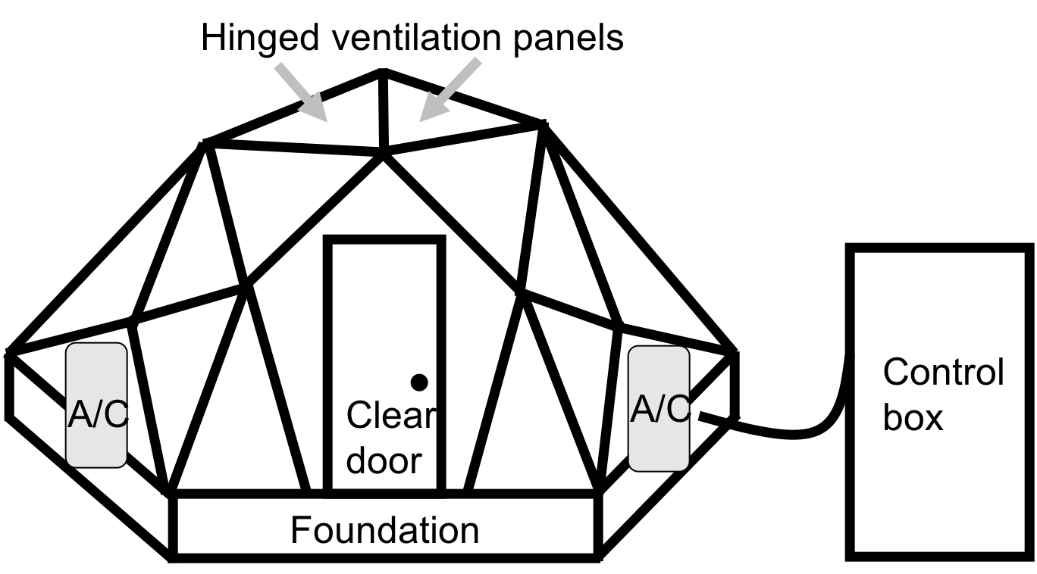
Looking forward: role of acclimation on future ecosystem feedbacks
nick.smith@ttu.edu; @nick_greg_smith
If plant demand for leaf nutrients decreases under elevated CO₂ (grey line), this could reduce belowground carbon allocation and soil respiration per NPP. Could test this with controlled experiments (right).

Slide 71
Conclusions
nick.smith@ttu.edu; @nick_greg_smith

Slide 72
Conclusions
nick.smith@ttu.edu; @nick_greg_smith
Plants aren’t dumb!
Assuming plants don’t dynamically respond to their environment can lead to poor understanding of ecosystem functioning
Dumb plants

Slide 73
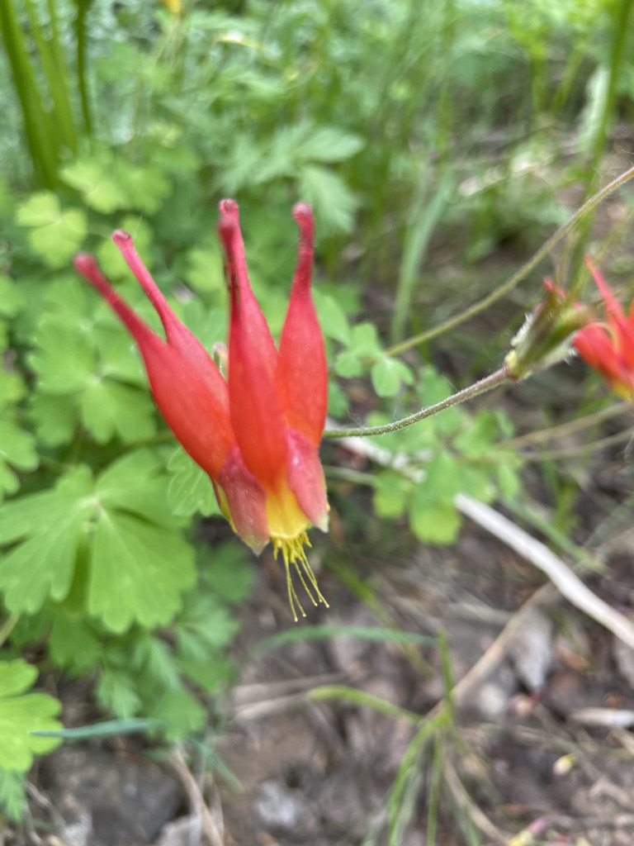
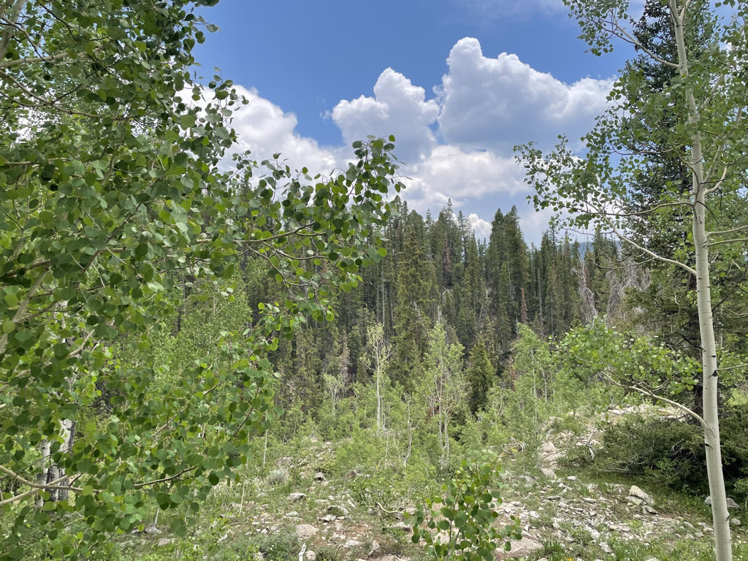
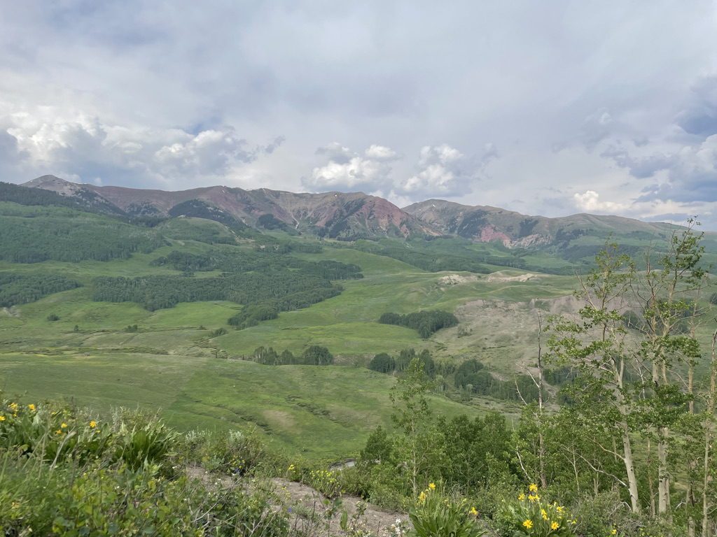
Conclusions
nick.smith@ttu.edu; @nick_greg_smith
Quantified physiological theory can:
Improve mechanistic understanding of physiological processes that underlie higher level responses
Produce more reliable future projections
f(x)
f(x)

Slide 74
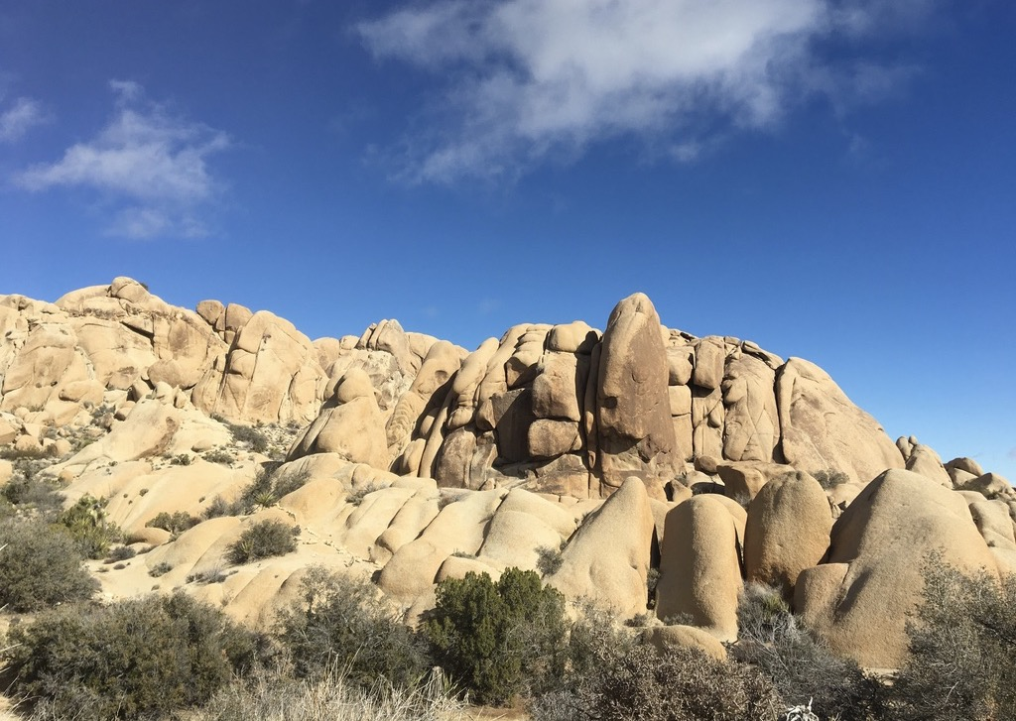
nick.smith@ttu.edu; @nick_greg_smith
Presentation available at:
www.github.com/SmithEcophysLab/seminar/2021_michigan
Thanks!

Slide 75
Question 4: When is C₄ photosynthesis an advantage over C₃ photosynthesis?
nick.smith@ttu.edu; @nick_greg_smith

Slide 76
C₃ versus C₄ optimization
nick.smith@ttu.edu; @nick_greg_smith

Slide 77
C₄ versus C₃ optimization
nick.smith@ttu.edu; @nick_greg_smith
C₄ photosynthesis has…
No photorespiration
An additional limitation (PEP carboxylation)

Slide 78
C₄ versus C₃ optimization
nick.smith@ttu.edu; @nick_greg_smith
C₄ photosynthesis has…
No photorespiration
An additional limitation (PEP carboxylation)

Slide 79
nick.smith@ttu.edu; @nick_greg_smith
Relative advantage of C₄ physiology
Scott and Smith (in review)

Slide 80
nick.smith@ttu.edu; @nick_greg_smith
Relative advantage of C₄ physiology
Scott and Smith (in review)

Slide 81
nick.smith@ttu.edu; @nick_greg_smith
Relative advantage of C₄ physiology
Scott and Smith (in review)

Slide 82
nick.smith@ttu.edu; @nick_greg_smith
Relative advantage of C₄ physiology
Scott and Smith (in review)

Slide 83
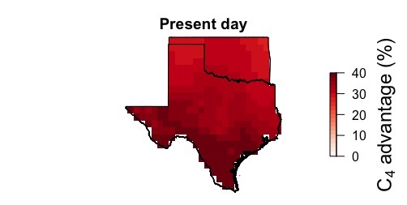
nick.smith@ttu.edu; @nick_greg_smith
Scott and Smith (in prep)

Slide 84
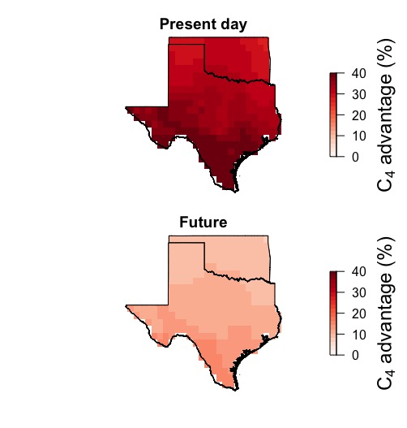
nick.smith@ttu.edu; @nick_greg_smith
Ansley et al. (in prep)

Slide 85
Question 4: When is C₄ photosynthesis an advantage over C₃ photosynthesis? C₄ is better in hot, dry, low CO₂ environments
nick.smith@ttu.edu; @nick_greg_smith

Slide 86
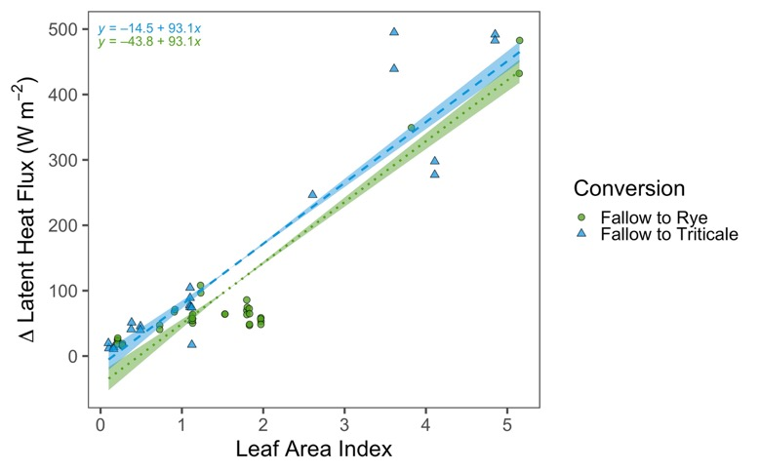
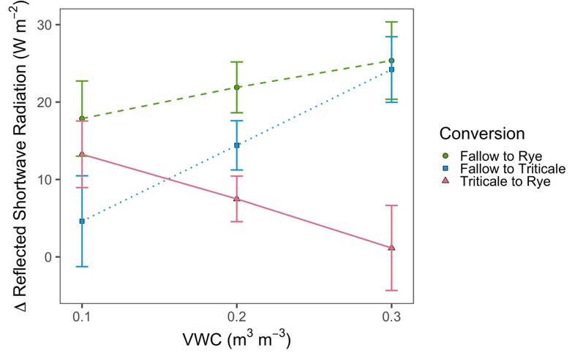
Looking forward: other ongoing and future research
nick.smith@ttu.edu; @nick_greg_smith
Land management modifications of plant-atmosphere feedbacks
Cover crop implementation increases latent heat flux (left) and albedo (right) as compared to fallow fields.
McNellis et al. (in review)

